Slide 1

UVA Brainhack!
===== Week 2 =====
6/6/2025

Slide 2
Agenda
Rivanna
MR crash course
Formal intro to python (?)
Hacking

Slide 3
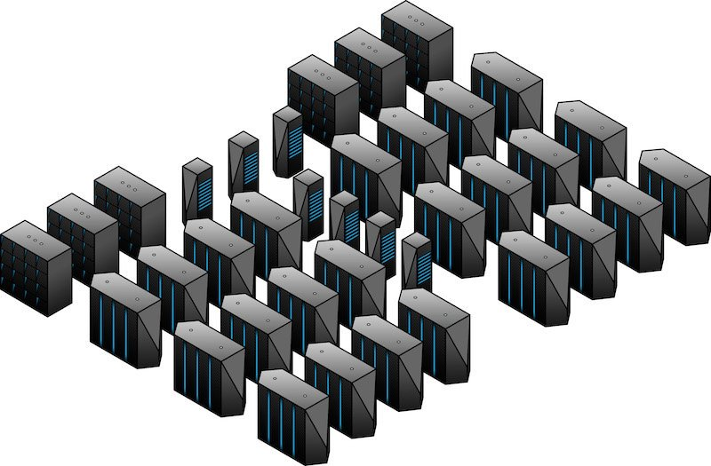
Rivanna
High-Performance Computing @UVA
www.rc.virginia.edu
Outsourcing computations to remote servers
Everyone has been added to morrislab!

Slide 4
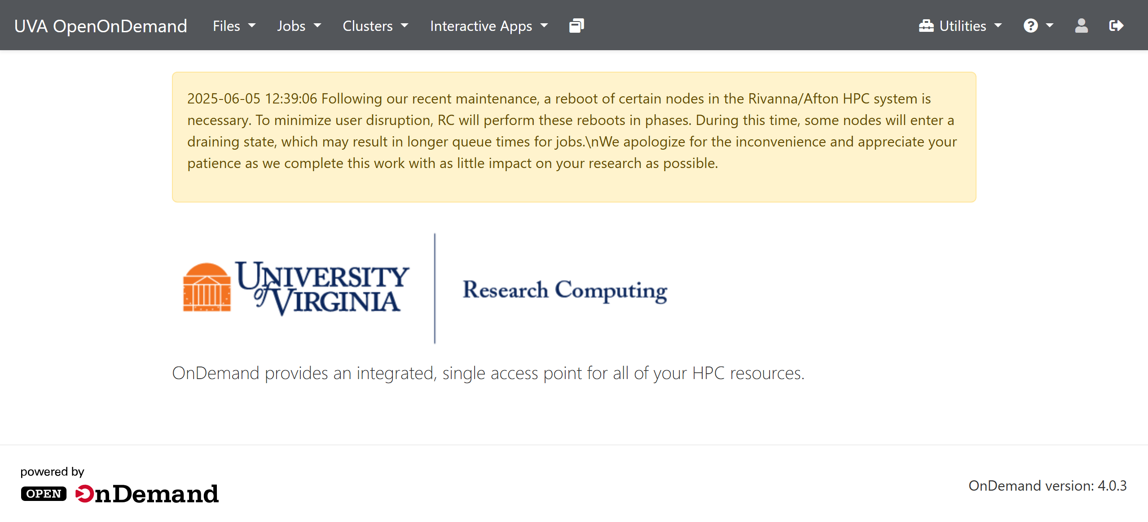


OnDemand
** Must be connected to UVA network **

Slide 5

MR Crash Course
Basics of image construction

Slide 6
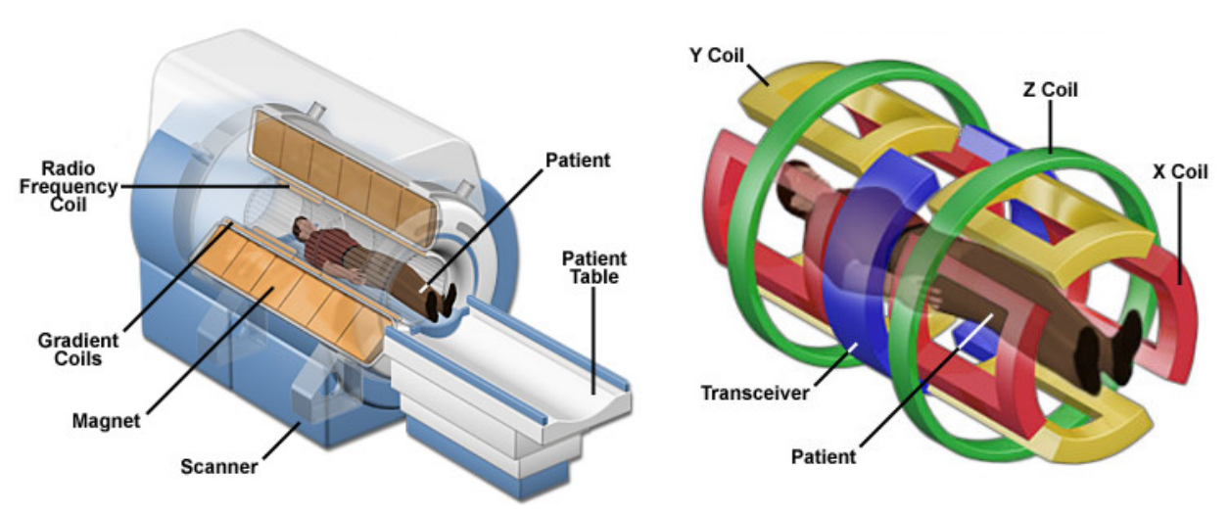
What is MRI?
Magnetic Resonance Imaging
(aka Nuclear Magnetic Resonance)

Slide 7
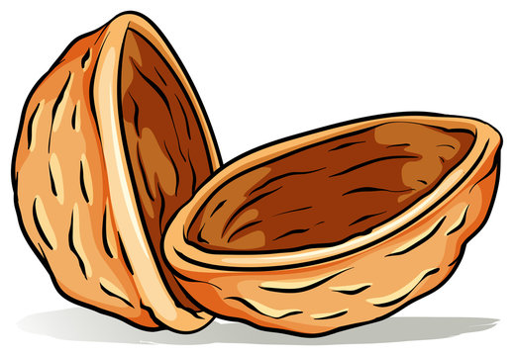
What is MRI?
Magnetic Resonance Imaging
(aka Nuclear Magnetic Resonance)
Using electromagnetism to perturb atomic nuclei and record how they respond to interference

Slide 8
MR physics
Caveat Emptor!
The following discussion will include:
Classical mechanical descriptions of quantum phenomena
Vector algebra (sort of)
Point particle representations
Notes:
Word to the wise
In the following discussion of MR Physics, I will be describing quantum phenomena in the language of classical mechanics. This is an approximation of the truth -- for 90 % of day-to-day MRI, the classical description is sufficient.
Ultimately, these phenomena are best understood through the lens of quantum mechanics.
Vector algebra instead of density notation
Point particles as opposed to wave functions

Slide 9
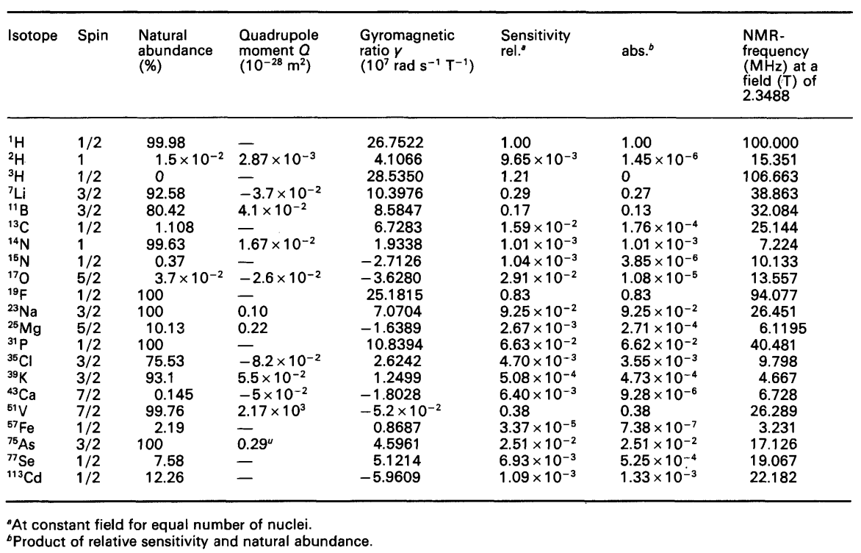
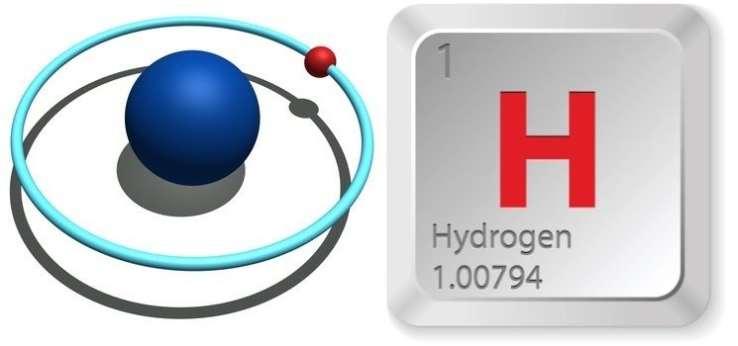
MR physics
“Nuclear” -- atomic nuclei with special properties:
Non-zero spin
Intrinsic angular momentum
Large “gyromagnetic ratio”
Generates a strong magnetic dipole moment
High charge-to-mass ratio
Abundant
~10¹⁹ /mm
Notes:
spin is an intrinsic form of angular momentum carried by elementary particles, composite particles (hadrons), and atomic nuclei
All elementary particles of a given kind have the same magnitude of spin angular momentum, which is indicated by assigning the particle a spin quantum number.

Slide 10
MR physics
“Nuclear” -- atomic nuclei with special properties:
Non-zero spin
Intrinsic angular momentum
Large “gyromagnetic ratio”
Generates a strong magnetic dipole moment
High charge-to-mass ratio
Abundant
~10¹⁹ /mm
Notes:
Hydrogen comprises 62% of the human body by number of atoms (10% by mass)

Slide 11
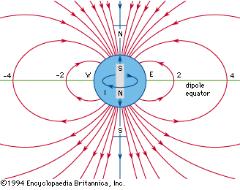
MR physics
“Magnetic”
Notes:
A bunch of tiny magnets

Slide 12
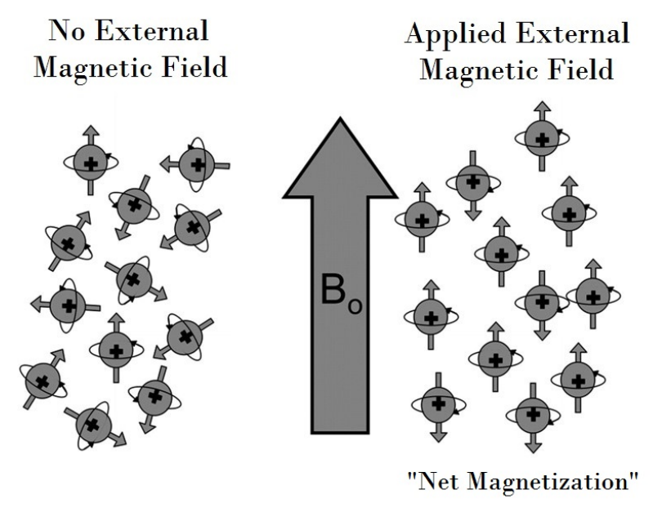
MR physics
Outside
Inside
“Magnetic”
Spin system
Notes:
A bunch of tiny magnets

Slide 13
MR physics
Outside
Inside
“Magnetic”
Spin system
Classical Mechanical View: magnetic moments align with applied external field
Notes:
A bunch of tiny magnets

Slide 14
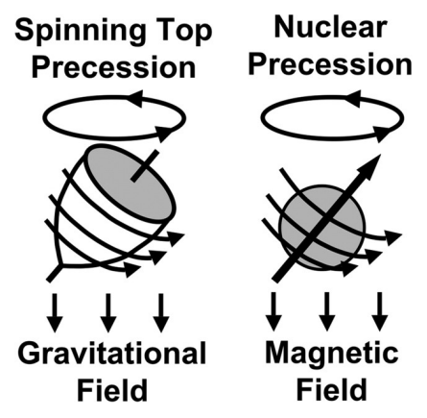
MR physics

Slide 15
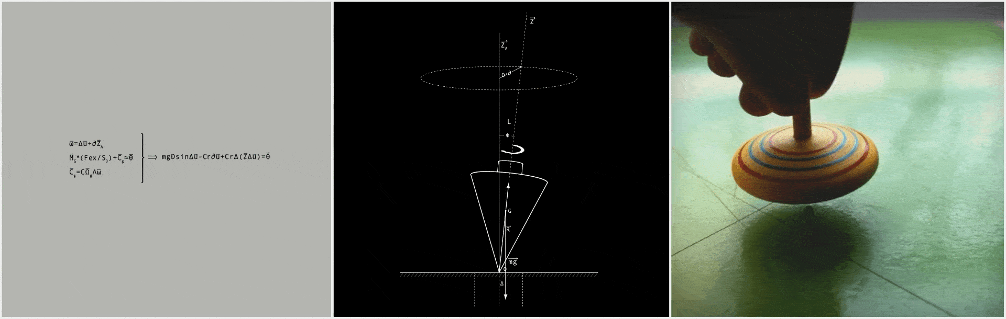
MR physics

Slide 16
MR physics

Slide 17
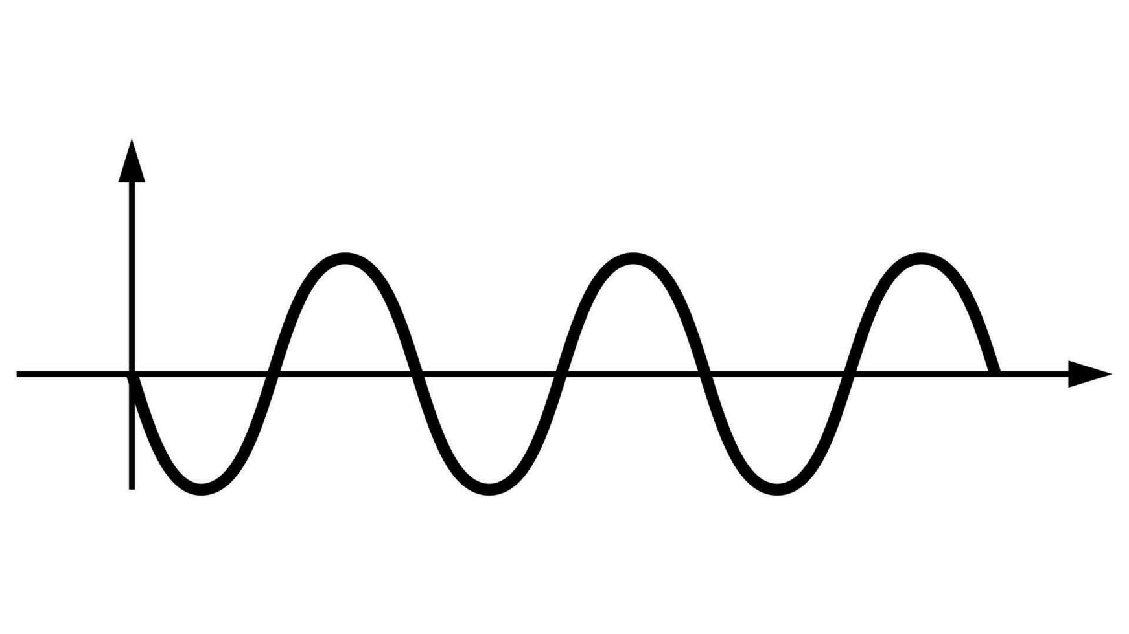
MR physics
B₀
“Larmour Frequency”
42.58 MHz/T
Aligned with B₀ and precessing at the same rate

Slide 18
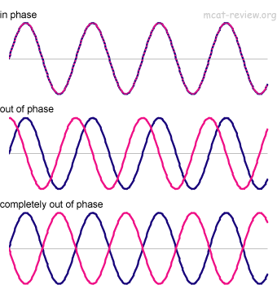
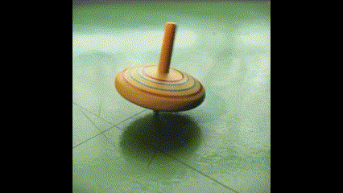
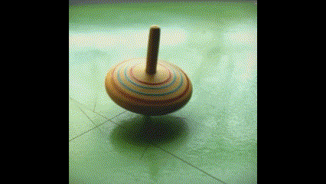
MR physics
Aligned with B₀ and precessing at the same rate
… But they’re out of phase!

Slide 19
MR physics
B₀

Slide 20
MR physics
Net magnetization vector for the spin system
(vector algebra)
Out of phase = transverse components sum to zero!

Slide 21
MR physics
Net magnetization vector for the spin system
(vector algebra)
Out of phase = transverse components sum to zero!
We are left with a static longitudinal component (no flux)
NO SIGNAL!

Slide 22
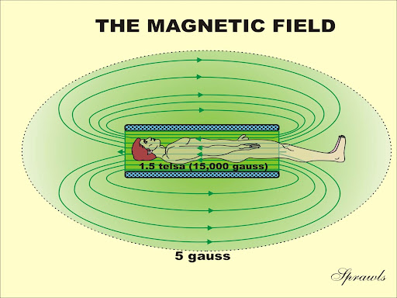
MR physics
TRANSVERSE
B₀
LONGITUDINAL

Slide 23
MR physics
B₀
B₀
LONGITUDINAL
TRANSVERSE

Slide 24

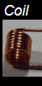
MR Physics
42.58MHz
“Resonance”
Notes:
Technically broad-band RF to capture band around Larmour frequency

Slide 25
MR Physics
42.58MHz
Inversion and recovery
LONGITUDINAL
TRANSVERSE
Notes:
Technically broad-band RF to capture band around Larmour frequency

Slide 26
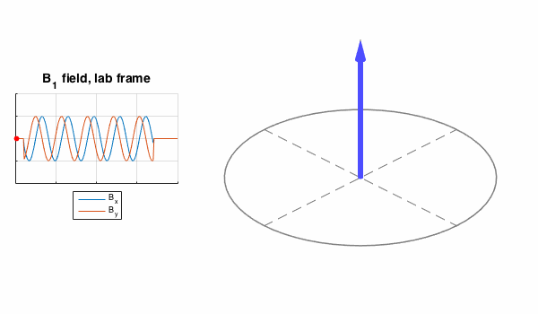
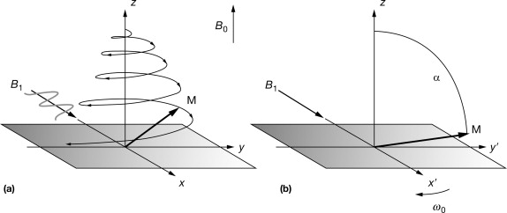
MR Physics
Inversion and recovery
Laboratory frame
Rotating frame
Notes:
Technically broad-band RF to capture band around Larmour frequency

Slide 27
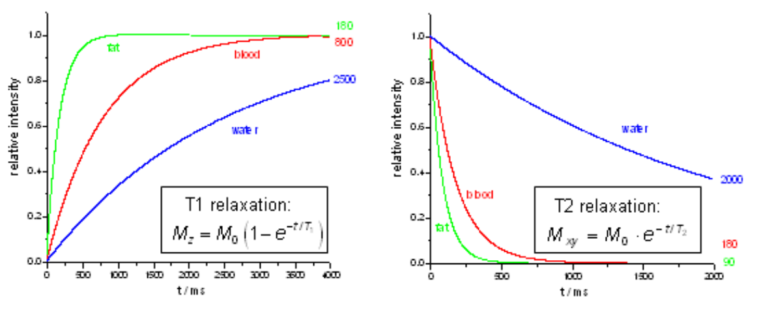
MR Physics
Inversion and recovery
Notes:
Technically broad-band RF to capture band around Larmour frequency

Slide 28
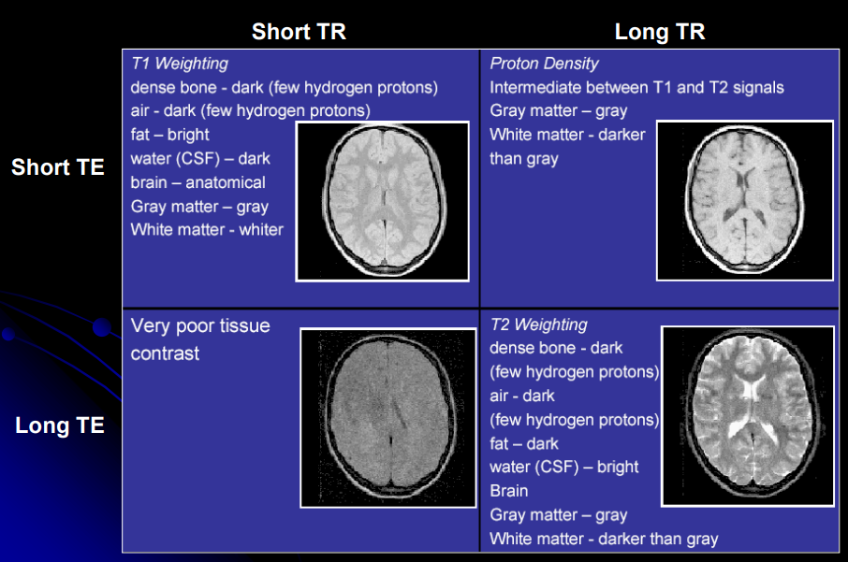
Contrast Weighting

Slide 29
Contrast Weighting
Inversion and recovery
LONGITUDINAL
T1 = longitudinal recovery rate
TRANSVERSE
T2 = transverse decay rate
Notes:
Technically broad-band RF to capture band around Larmour frequency

Slide 30
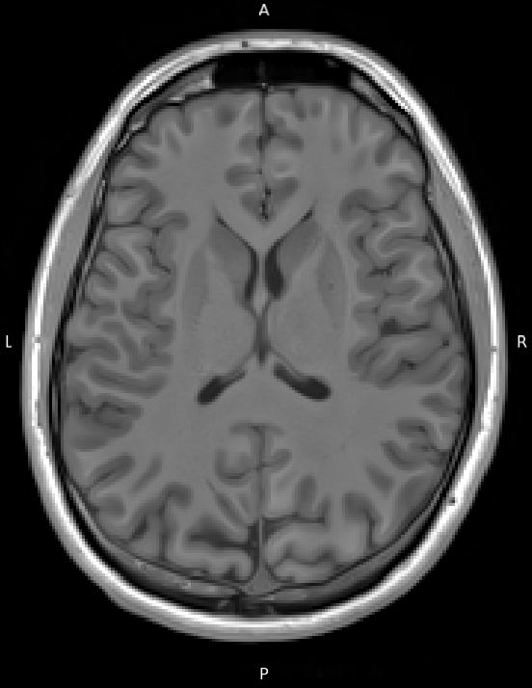
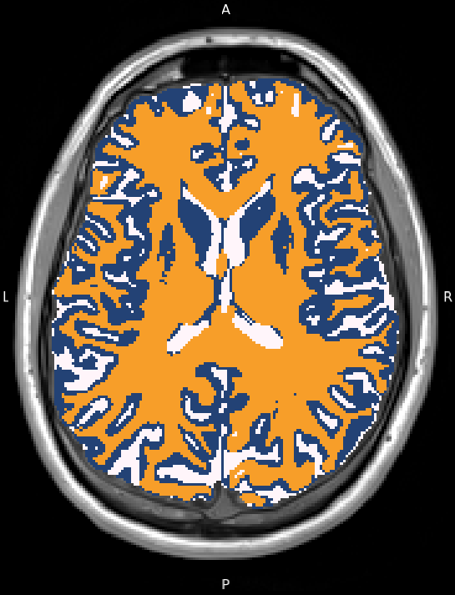
Structural MRI
T1-weighted
Notes:
This is an example T1w image, which optimizes the contrast between fatty tissue and water, with other tissue types falling somewhere in-between. These are not BOLD-sensitive (aka ‘functional’). Rather, these are static structural images.
Macrostructure (if that wasn’t obvious)

Slide 31
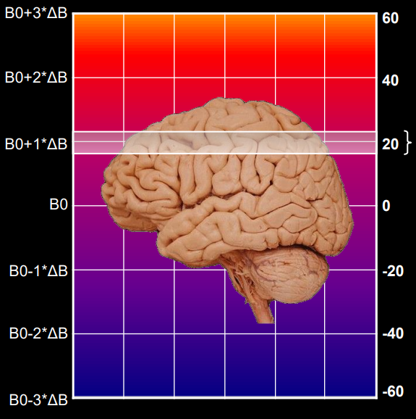
Structural MRI
Faster precession
Image generation (finally)
Gradients are the key!
z
Slower precession
Notes:
Draw it out

Slide 32
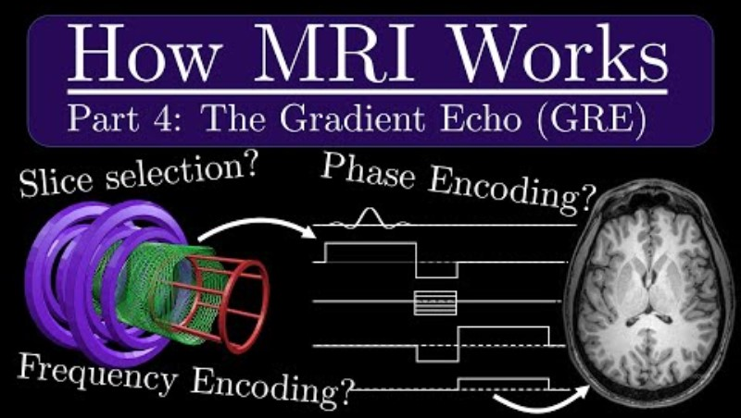
YouTube

Slide 33
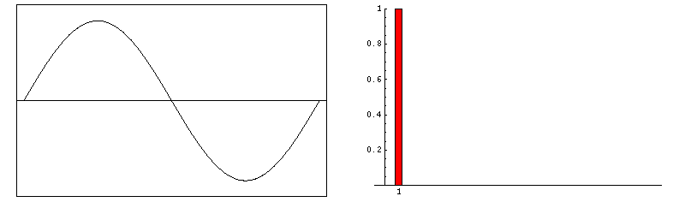
Structural MRI
Image generation (finally)
Complex signal decomposition: Fourier transform
Notes:
Draw it out

Slide 34
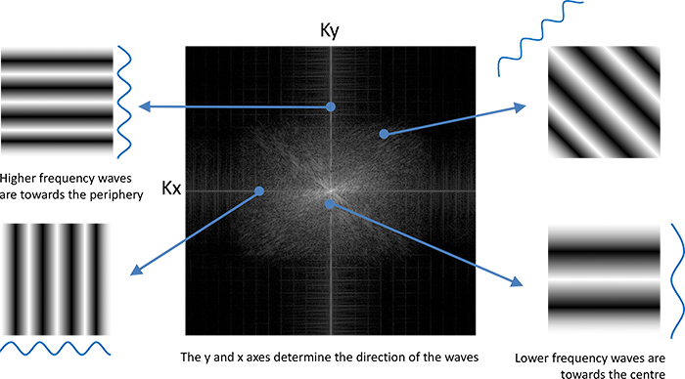
K Space

Slide 35
K Space

Slide 36
BOLD fMRI
The BOLD effect
Neurons need O₂ for aerobic metabolism (main source of ATP)
When action potential occurs, calcium signalling leads to downstream hemodylation, causing an influx of diamagnetic hemoglobin (Hb)

Slide 37
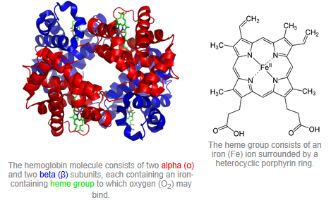
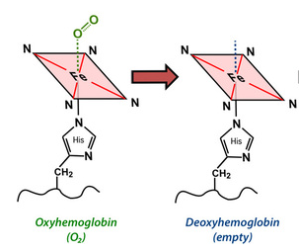
BOLD fMRI
Hb

Slide 38
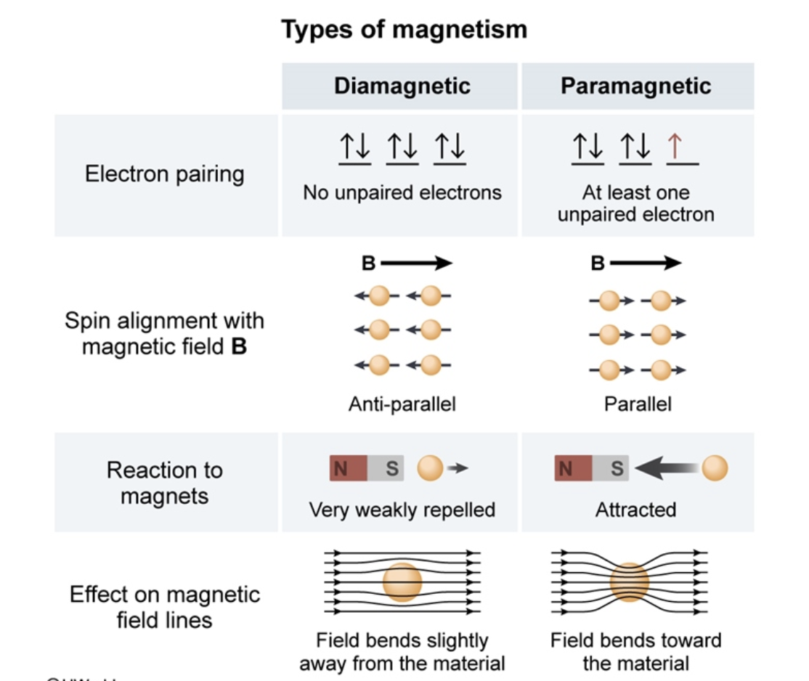
BOLD fMRI
Hb → dHb

Slide 39
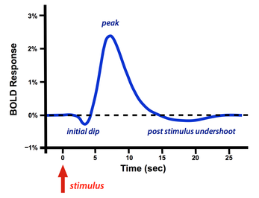
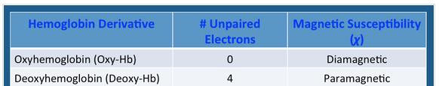
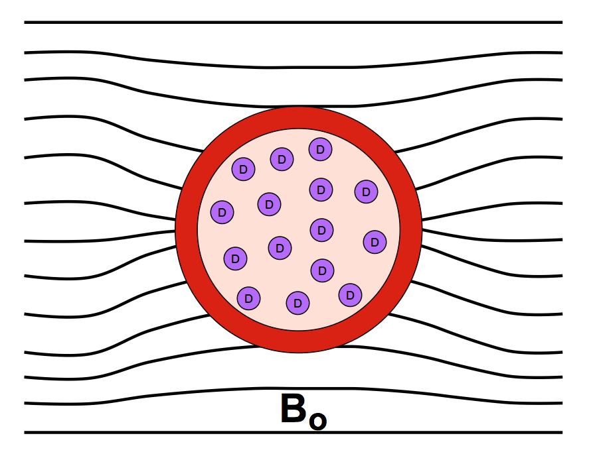
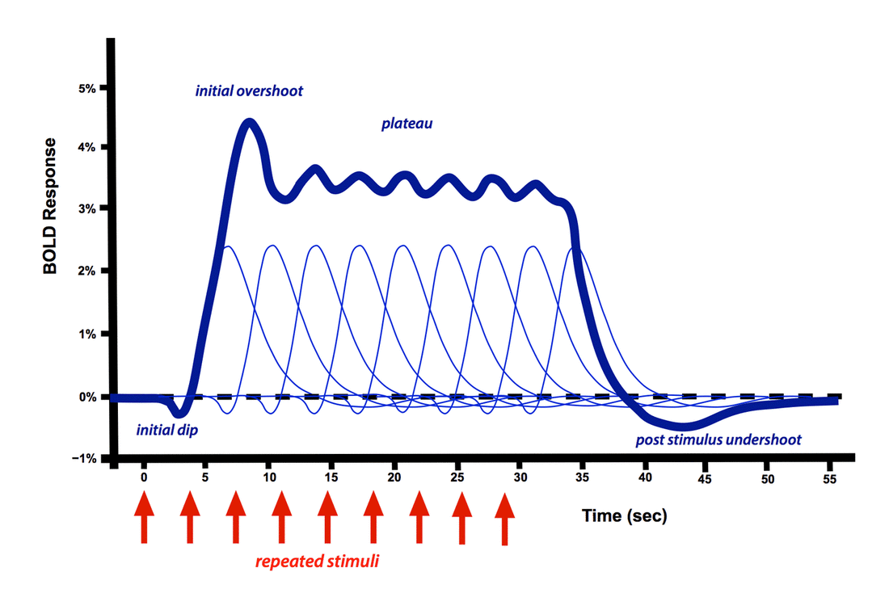
BOLD fMRI
The BOLD effect

Slide 40
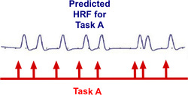
BOLD fMRI
Task-based vs. resting-state paradigms
Task-based = evoking HDR
Expect to see change in BOLD signal at specific location / cluster of voxels

Slide 41
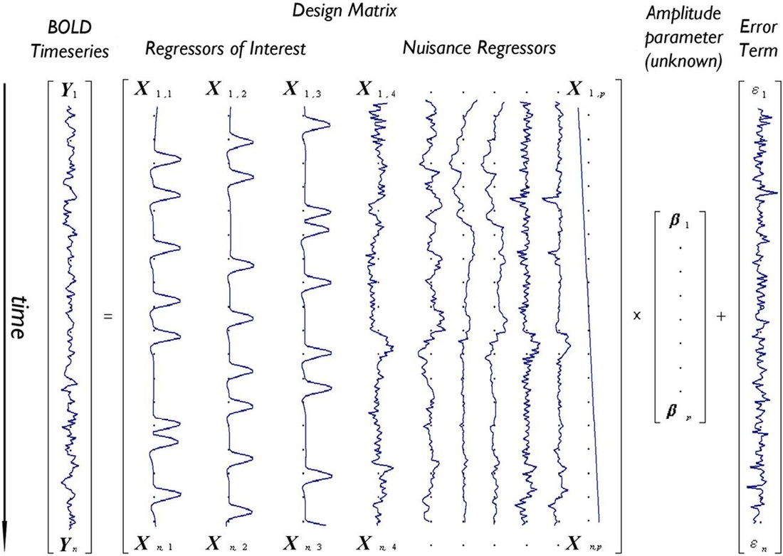
BOLD fMRI
GLM
https://mriquestions.com/general-linear-model.html
Notes:
Each voxel has its own timeseries

Slide 42
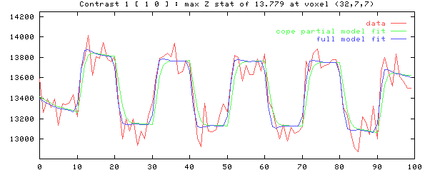
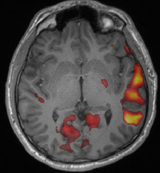
BOLD fMRI
GLM
z-map
https://mriquestions.com/general-linear-model.html

Slide 43
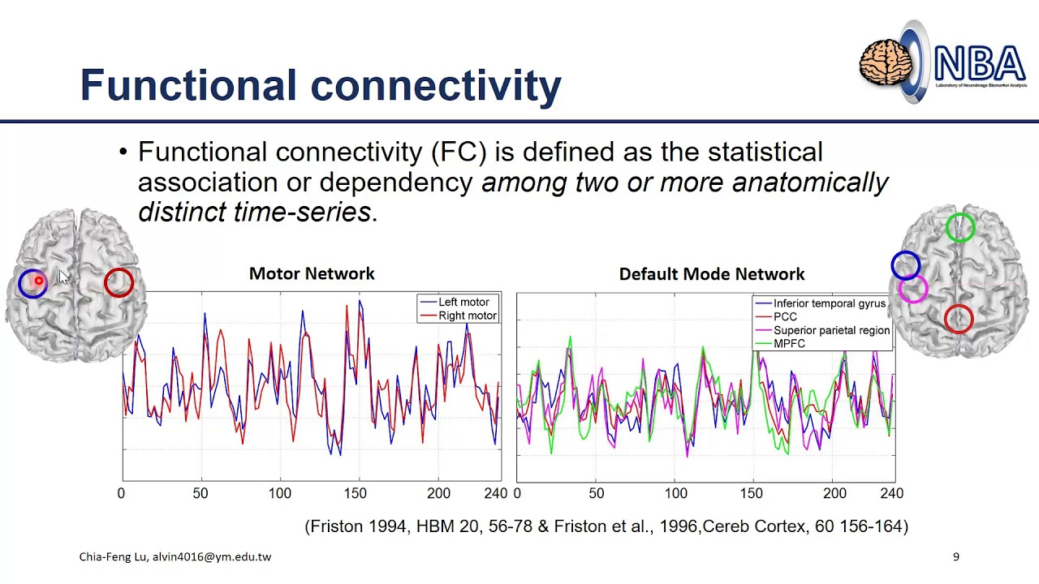
BOLD fMRI
Resting-state fMRI

Slide 44
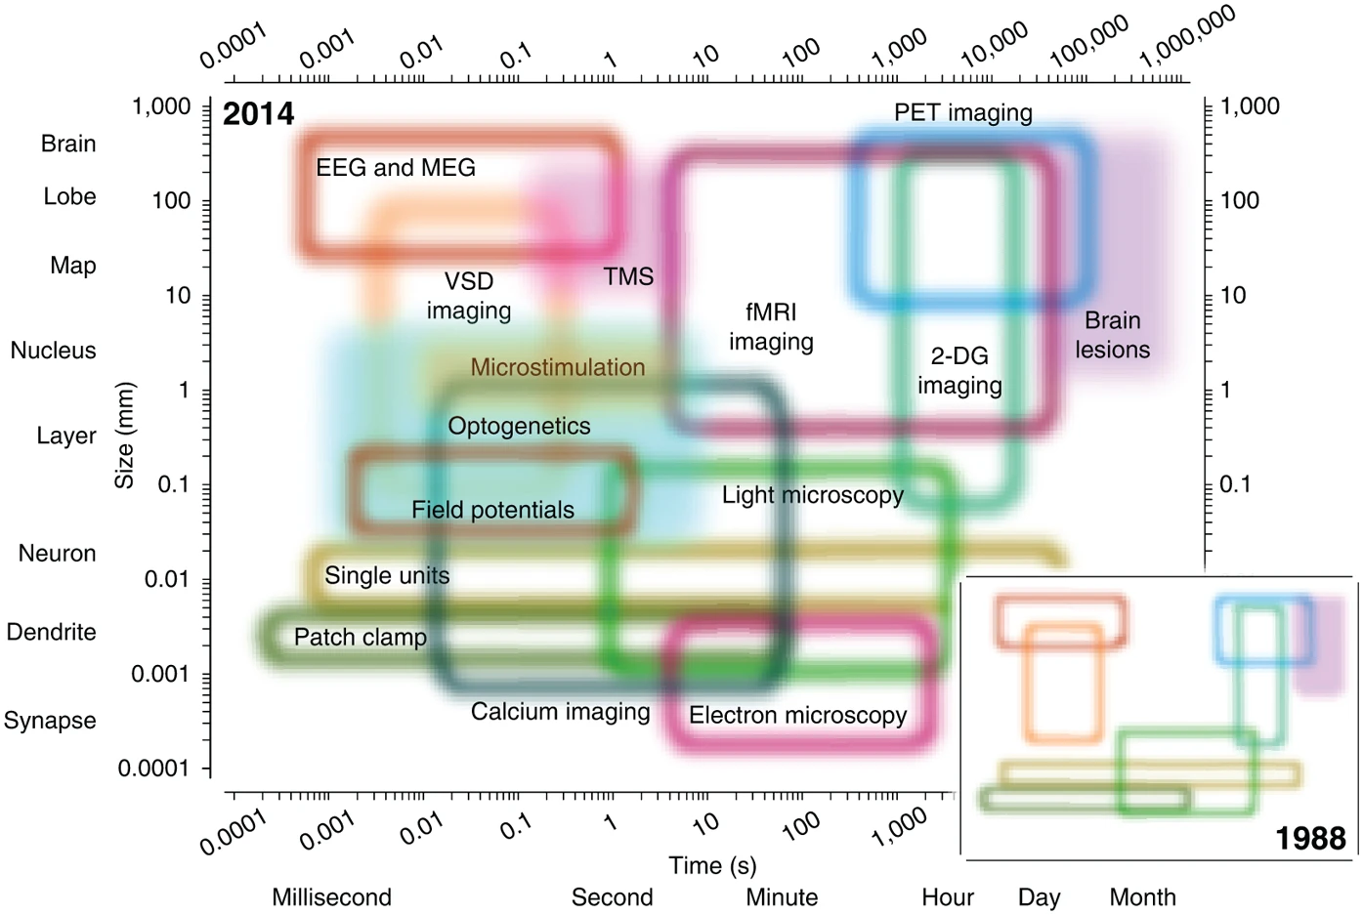
BOLD fMRI
Low-res
Hi-res
Sejnowski, Churchland and Movshon, 2014, Nature Neuroscience
Notes:
Ours is a blunt instrument
Not able to capture micro-scale phenomena

Slide 45
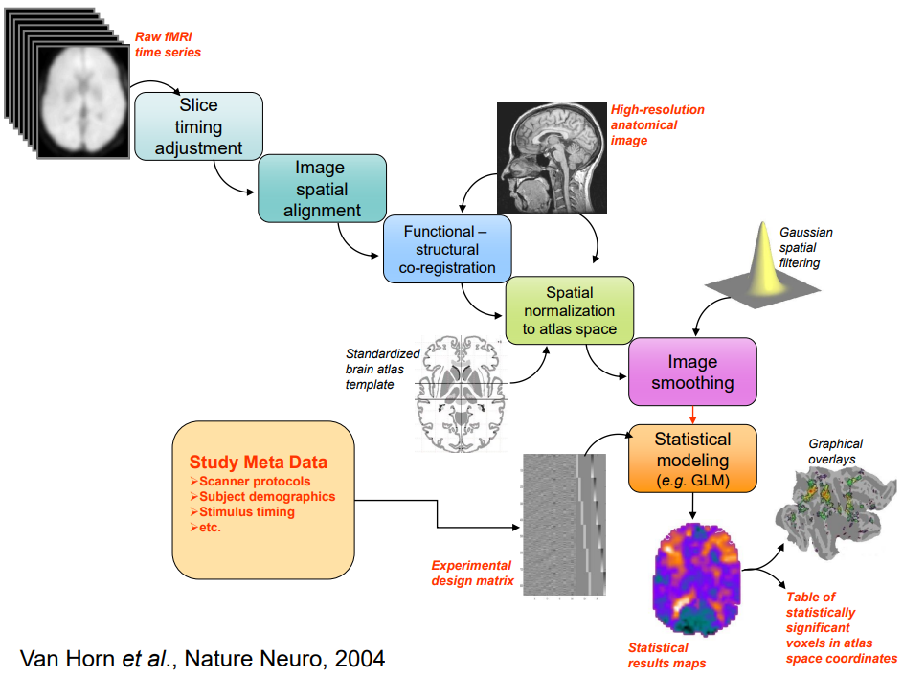
Processing Pipeline

Slide 46
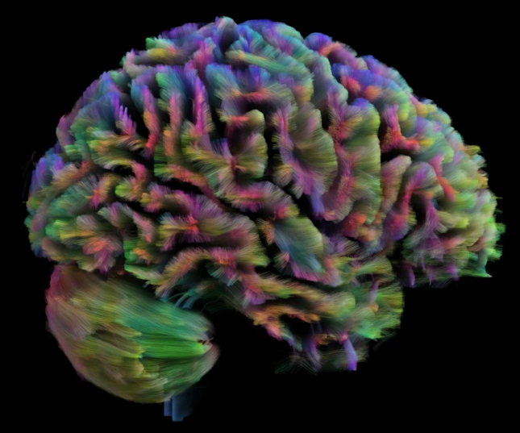
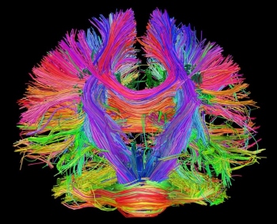
Diffusion Imaging
Van Horn, J. D. (2023)
Notes:
Water Diffusion:
Water molecules undergo random, thermally-driven motion, known as Brownian motion. This diffusion is influenced by the microstructural environment.
In free water, diffusion is unrestricted. In biological tissues, barriers like cell membranes, myelin sheaths, and organelles hinder diffusion, making it anisotropic (directionally dependent).
Sensitivity to Diffusion:
DW-MRI encodes the movement of water molecules into the MRI signal using magnetic field gradients. This encoding allows the detection of microscopic variations in diffusion that provide insights into tissue structure and pathology.
2. The DW-MRI Pulse Sequence
DW-MRI uses a modified spin-echo sequence with added diffusion-sensitizing gradients. The typical sequence involves the following components:
a. Standard Spin-Echo Sequence
90° RF Pulse:
Excites the spins in the tissue, tipping them into the transverse plane.
180° RF Pulse:
Refocuses the spins, forming a spin echo to correct for inhomogeneities in the static magnetic field (B0B_0B0​).
b. Diffusion Gradients
To make the sequence sensitive to diffusion, two additional gradients are applied symmetrically around the 180° RF pulse:
First Gradient (Dephasing):
A magnetic field gradient is applied to dephase the spins based on their position in space. Spins in moving water molecules are now phase-shifted according to their displacement.
Second Gradient (Rephasing):
Another magnetic gradient, with the same amplitude and duration as the first, is applied after the 180° RF pulse. If a water molecule has not moved, its phase shift is reversed, and the spin rephases. However, if the water molecule has moved, it will not completely rephase, leading to signal attenuation.
3. Key Parameters in DW-MRI
b-Value:
A measure of the strength and timing of the diffusion gradients, expressed in s/mm². It determines the sensitivity of the sequence to diffusion.
Higher bbb-values increase sensitivity to diffusion but also lead to lower signal-to-noise ratios (SNR).
Typical bbb-values are:
Low ( 0s/mm2~0 s/mm² 0s/mm2): No diffusion weighting.
Intermediate ( 500–1000s/mm2~500–1000 s/mm² 500–1000s/mm2): General diffusion imaging.
High ( 2000+s/mm2~2000+ s/mm² 2000+s/mm2): Characterizing restricted diffusion (e.g., in tightly packed tumor cells).
Echo Time (TE):
The time between the 90° RF pulse and the peak of the spin echo. Longer TE values allow for more diffusion sensitivity but may reduce SNR.
Repetition Time (TR):
The time between successive excitations. TR is typically set long enough to allow full longitudinal relaxation and avoid T1 weighting.
4. Signal Attenuation in DW-MRI
The MRI signal in a diffusion-weighted image is attenuated according to the Stejskal-Tanner equation:
S=S0e−bDS = S_0 e^{-bD}S=S0​e−bD
SSS: Signal intensity in the diffusion-weighted image.
S0S_0S0​: Signal intensity without diffusion weighting (b=0b = 0b=0).
bbb: Diffusion weighting factor (dependent on gradient strength, duration, and spacing).
DDD: Apparent diffusion coefficient (ADC), a measure of the diffusion rate.
5. Data Representation and Analysis
a. Apparent Diffusion Coefficient (ADC) Maps
ADC maps are calculated by acquiring images with different bbb-values and fitting the Stejskal-Tanner equation to estimate the diffusion coefficient for each voxel.
Bright regions on ADC maps indicate fast diffusion (e.g., free water).
Dark regions on ADC maps indicate restricted diffusion (e.g., cytotoxic edema in stroke).
b. Diffusion Tensor Imaging (DTI)
DTI is an extension of DW-MRI that models diffusion as a tensor, capturing the directionality (anisotropy) of water diffusion.
DTI requires diffusion measurements in multiple directions (typically >6).
Outputs include:
Fractional Anisotropy (FA): A measure of the directionality of diffusion.
Mean Diffusivity (MD): The average diffusion rate.
Principal Eigenvectors: Used to map white matter tracts.

Slide 47
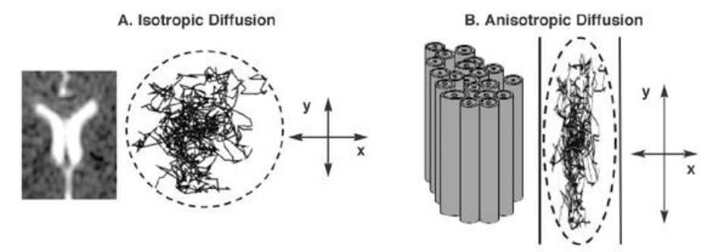
Diffusion Imaging
Tracking water diffusion (along axons)
Rosenbloom et al., 2004
Notes:
Water Diffusion:
Water molecules undergo random, thermally-driven motion, known as Brownian motion. This diffusion is influenced by the microstructural environment.
In free water, diffusion is unrestricted. In biological tissues, barriers like cell membranes, myelin sheaths, and organelles hinder diffusion, making it anisotropic (directionally dependent).
Sensitivity to Diffusion:
DW-MRI encodes the movement of water molecules into the MRI signal using magnetic field gradients. This encoding allows the detection of microscopic variations in diffusion that provide insights into tissue structure and pathology.
2. The DW-MRI Pulse Sequence
DW-MRI uses a modified spin-echo sequence with added diffusion-sensitizing gradients. The typical sequence involves the following components:
a. Standard Spin-Echo Sequence
90° RF Pulse:
Excites the spins in the tissue, tipping them into the transverse plane.
180° RF Pulse:
Refocuses the spins, forming a spin echo to correct for inhomogeneities in the static magnetic field (B0B_0B0​).
b. Diffusion Gradients
To make the sequence sensitive to diffusion, two additional gradients are applied symmetrically around the 180° RF pulse:
First Gradient (Dephasing):
A magnetic field gradient is applied to dephase the spins based on their position in space. Spins in moving water molecules are now phase-shifted according to their displacement.
Second Gradient (Rephasing):
Another magnetic gradient, with the same amplitude and duration as the first, is applied after the 180° RF pulse. If a water molecule has not moved, its phase shift is reversed, and the spin rephases. However, if the water molecule has moved, it will not completely rephase, leading to signal attenuation.
3. Key Parameters in DW-MRI
b-Value:
A measure of the strength and timing of the diffusion gradients, expressed in s/mm². It determines the sensitivity of the sequence to diffusion.
Higher bbb-values increase sensitivity to diffusion but also lead to lower signal-to-noise ratios (SNR).
Typical bbb-values are:
Low ( 0s/mm2~0 s/mm² 0s/mm2): No diffusion weighting.
Intermediate ( 500–1000s/mm2~500–1000 s/mm² 500–1000s/mm2): General diffusion imaging.
High ( 2000+s/mm2~2000+ s/mm² 2000+s/mm2): Characterizing restricted diffusion (e.g., in tightly packed tumor cells).
Echo Time (TE):
The time between the 90° RF pulse and the peak of the spin echo. Longer TE values allow for more diffusion sensitivity but may reduce SNR.
Repetition Time (TR):
The time between successive excitations. TR is typically set long enough to allow full longitudinal relaxation and avoid T1 weighting.
4. Signal Attenuation in DW-MRI
The MRI signal in a diffusion-weighted image is attenuated according to the Stejskal-Tanner equation:
S=S0e−bDS = S_0 e^{-bD}S=S0​e−bD
SSS: Signal intensity in the diffusion-weighted image.
S0S_0S0​: Signal intensity without diffusion weighting (b=0b = 0b=0).
bbb: Diffusion weighting factor (dependent on gradient strength, duration, and spacing).
DDD: Apparent diffusion coefficient (ADC), a measure of the diffusion rate.
5. Data Representation and Analysis
a. Apparent Diffusion Coefficient (ADC) Maps
ADC maps are calculated by acquiring images with different bbb-values and fitting the Stejskal-Tanner equation to estimate the diffusion coefficient for each voxel.
Bright regions on ADC maps indicate fast diffusion (e.g., free water).
Dark regions on ADC maps indicate restricted diffusion (e.g., cytotoxic edema in stroke).
b. Diffusion Tensor Imaging (DTI)
DTI is an extension of DW-MRI that models diffusion as a tensor, capturing the directionality (anisotropy) of water diffusion.
DTI requires diffusion measurements in multiple directions (typically >6).
Outputs include:
Fractional Anisotropy (FA): A measure of the directionality of diffusion.
Mean Diffusivity (MD): The average diffusion rate.
Principal Eigenvectors: Used to map white matter tracts.

Slide 48
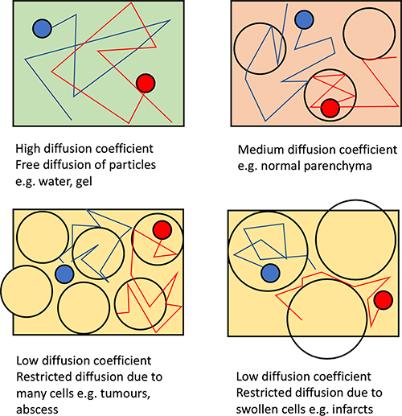
Diffusion Imaging
Apparent diffusion coefficient (ADC)
https://www.radiologycafe.com/frcr-physics-notes/mr-imaging/diffusion-weighted-imaging/
Notes:
Water Diffusion:
Water molecules undergo random, thermally-driven motion, known as Brownian motion. This diffusion is influenced by the microstructural environment.
In free water, diffusion is unrestricted. In biological tissues, barriers like cell membranes, myelin sheaths, and organelles hinder diffusion, making it anisotropic (directionally dependent).
Sensitivity to Diffusion:
DW-MRI encodes the movement of water molecules into the MRI signal using magnetic field gradients. This encoding allows the detection of microscopic variations in diffusion that provide insights into tissue structure and pathology.
2. The DW-MRI Pulse Sequence
DW-MRI uses a modified spin-echo sequence with added diffusion-sensitizing gradients. The typical sequence involves the following components:
a. Standard Spin-Echo Sequence
90° RF Pulse:
Excites the spins in the tissue, tipping them into the transverse plane.
180° RF Pulse:
Refocuses the spins, forming a spin echo to correct for inhomogeneities in the static magnetic field (B0B_0B0​).
b. Diffusion Gradients
To make the sequence sensitive to diffusion, two additional gradients are applied symmetrically around the 180° RF pulse:
First Gradient (Dephasing):
A magnetic field gradient is applied to dephase the spins based on their position in space. Spins in moving water molecules are now phase-shifted according to their displacement.
Second Gradient (Rephasing):
Another magnetic gradient, with the same amplitude and duration as the first, is applied after the 180° RF pulse. If a water molecule has not moved, its phase shift is reversed, and the spin rephases. However, if the water molecule has moved, it will not completely rephase, leading to signal attenuation.
3. Key Parameters in DW-MRI
b-Value:
A measure of the strength and timing of the diffusion gradients, expressed in s/mm². It determines the sensitivity of the sequence to diffusion.
Higher bbb-values increase sensitivity to diffusion but also lead to lower signal-to-noise ratios (SNR).
Typical bbb-values are:
Low ( 0s/mm2~0 s/mm² 0s/mm2): No diffusion weighting.
Intermediate ( 500–1000s/mm2~500–1000 s/mm² 500–1000s/mm2): General diffusion imaging.
High ( 2000+s/mm2~2000+ s/mm² 2000+s/mm2): Characterizing restricted diffusion (e.g., in tightly packed tumor cells).
Echo Time (TE):
The time between the 90° RF pulse and the peak of the spin echo. Longer TE values allow for more diffusion sensitivity but may reduce SNR.
Repetition Time (TR):
The time between successive excitations. TR is typically set long enough to allow full longitudinal relaxation and avoid T1 weighting.
4. Signal Attenuation in DW-MRI
The MRI signal in a diffusion-weighted image is attenuated according to the Stejskal-Tanner equation:
S=S0e−bDS = S_0 e^{-bD}S=S0​e−bD
SSS: Signal intensity in the diffusion-weighted image.
S0S_0S0​: Signal intensity without diffusion weighting (b=0b = 0b=0).
bbb: Diffusion weighting factor (dependent on gradient strength, duration, and spacing).
DDD: Apparent diffusion coefficient (ADC), a measure of the diffusion rate.
5. Data Representation and Analysis
a. Apparent Diffusion Coefficient (ADC) Maps
ADC maps are calculated by acquiring images with different bbb-values and fitting the Stejskal-Tanner equation to estimate the diffusion coefficient for each voxel.
Bright regions on ADC maps indicate fast diffusion (e.g., free water).
Dark regions on ADC maps indicate restricted diffusion (e.g., cytotoxic edema in stroke).
b. Diffusion Tensor Imaging (DTI)
DTI is an extension of DW-MRI that models diffusion as a tensor, capturing the directionality (anisotropy) of water diffusion.
DTI requires diffusion measurements in multiple directions (typically >6).
Outputs include:
Fractional Anisotropy (FA): A measure of the directionality of diffusion.
Mean Diffusivity (MD): The average diffusion rate.
Principal Eigenvectors: Used to map white matter tracts.

Slide 49
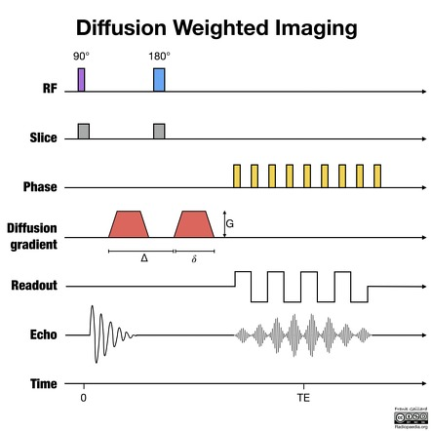
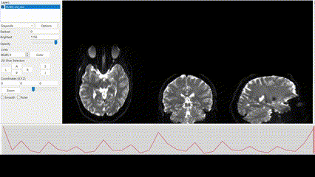
Diffusion Imaging
Phase tagging
Notes:
Phase tagging in diffusion-weighted imaging (DWI) refers to a method used to encode diffusion information into the phase of the MRI signal. Unlike conventional DWI, where diffusion effects are primarily encoded in the signal amplitude (magnitude), phase tagging leverages phase shifts induced by the motion of spins in the presence of diffusion gradients. This approach can provide detailed information about diffusion and flow, with applications in imaging complex tissue structures or assessing flow dynamics.
Water Diffusion:
Water molecules undergo random, thermally-driven motion, known as Brownian motion. This diffusion is influenced by the microstructural environment.
In free water, diffusion is unrestricted. In biological tissues, barriers like cell membranes, myelin sheaths, and organelles hinder diffusion, making it anisotropic (directionally dependent).
Sensitivity to Diffusion:
DW-MRI encodes the movement of water molecules into the MRI signal using magnetic field gradients. This encoding allows the detection of microscopic variations in diffusion that provide insights into tissue structure and pathology.
2. The DW-MRI Pulse Sequence
DW-MRI uses a modified spin-echo sequence with added diffusion-sensitizing gradients. The typical sequence involves the following components:
a. Standard Spin-Echo Sequence
90° RF Pulse:
Excites the spins in the tissue, tipping them into the transverse plane.
180° RF Pulse:
Refocuses the spins, forming a spin echo to correct for inhomogeneities in the static magnetic field (B0B_0B0​).
b. Diffusion Gradients
To make the sequence sensitive to diffusion, two additional gradients are applied symmetrically around the 180° RF pulse:
First Gradient (Dephasing):
A magnetic field gradient is applied to dephase the spins based on their position in space. Spins in moving water molecules are now phase-shifted according to their displacement.
Second Gradient (Rephasing):
Another magnetic gradient, with the same amplitude and duration as the first, is applied after the 180° RF pulse. If a water molecule has not moved, its phase shift is reversed, and the spin rephases. However, if the water molecule has moved, it will not completely rephase, leading to signal attenuation.
3. Key Parameters in DW-MRI
b-Value:
A measure of the strength and timing of the diffusion gradients, expressed in s/mm². It determines the sensitivity of the sequence to diffusion.
Higher bbb-values increase sensitivity to diffusion but also lead to lower signal-to-noise ratios (SNR).
Typical bbb-values are:
Low ( 0s/mm2~0 s/mm² 0s/mm2): No diffusion weighting.
Intermediate ( 500–1000s/mm2~500–1000 s/mm² 500–1000s/mm2): General diffusion imaging.
High ( 2000+s/mm2~2000+ s/mm² 2000+s/mm2): Characterizing restricted diffusion (e.g., in tightly packed tumor cells).
Echo Time (TE):
The time between the 90° RF pulse and the peak of the spin echo. Longer TE values allow for more diffusion sensitivity but may reduce SNR.
Repetition Time (TR):
The time between successive excitations. TR is typically set long enough to allow full longitudinal relaxation and avoid T1 weighting.
4. Signal Attenuation in DW-MRI
The MRI signal in a diffusion-weighted image is attenuated according to the Stejskal-Tanner equation:
S=S0e−bDS = S_0 e^{-bD}S=S0​e−bD
SSS: Signal intensity in the diffusion-weighted image.
S0S_0S0​: Signal intensity without diffusion weighting (b=0b = 0b=0).
bbb: Diffusion weighting factor (dependent on gradient strength, duration, and spacing).
DDD: Apparent diffusion coefficient (ADC), a measure of the diffusion rate.
5. Data Representation and Analysis
a. Apparent Diffusion Coefficient (ADC) Maps
ADC maps are calculated by acquiring images with different bbb-values and fitting the Stejskal-Tanner equation to estimate the diffusion coefficient for each voxel.
Bright regions on ADC maps indicate fast diffusion (e.g., free water).
Dark regions on ADC maps indicate restricted diffusion (e.g., cytotoxic edema in stroke).
b. Diffusion Tensor Imaging (DTI)
DTI is an extension of DW-MRI that models diffusion as a tensor, capturing the directionality (anisotropy) of water diffusion.
DTI requires diffusion measurements in multiple directions (typically >6).
Outputs include:
Fractional Anisotropy (FA): A measure of the directionality of diffusion.
Mean Diffusivity (MD): The average diffusion rate.
Principal Eigenvectors: Used to map white matter tracts.

Slide 50
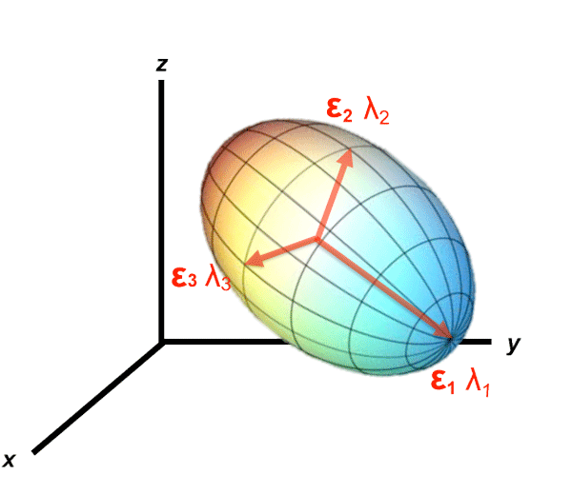
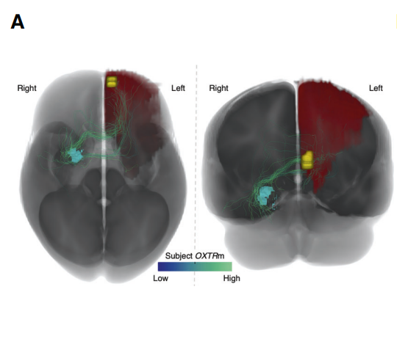
Diffusion Imaging
https://mriquestions.com
Skyberg et al., 2023
Notes:
Phase tagging

